Slide 1

The role of vapor pressure deficit in crop yield
under a changing climate
Jennifer Hsiao, Abigail L.S. Swann, Soo-Hyung Kim
University of Washington

Slide 2
Tight coupling between
temperature & vapor pressure deficit
Temp
VPD
Saturated Air
VPD
Water Vapor
Non-saturated Air
Temp
Temp
Temp

Slide 3

Process-based crop mode - MAIZSIM
Solar radiation
Temperature
Precipitation
VPD, CO₂ levels
Stomatal
conductance
Atmospheric water demand
Leaf elongation & development
Photosynthesis
Carbon partitioning
H₂O
Phenological timeline
Soil module tracking water status

Slide 4
4 simulation sites across US corn belt
Iowa
Ohio
Nebraska
Oklahoma

Slide 5
Temp
2˚C warming, constant VPD
VPD
VPD change associated with 2˚C warming, constant temperature
CO₂
Doubling CO₂ (from 400 to 800 ppm)

Slide 6
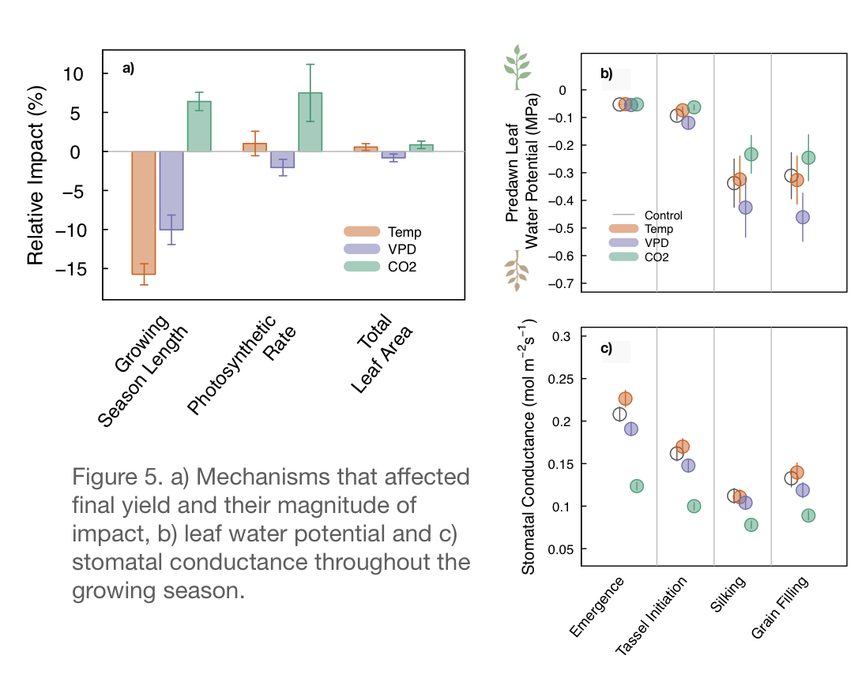
Both warming & drying in the air (increased VPD) can reduce crop yield under a changing climate
Yield Impact
Mechanisms
Yield loss from higher temperatures are mainly caused by a shorter growing season
Higher VPD increases water demand from the atmosphere and reduces yield through water stress responses, i.e. stomatal closure, reduced leaf area development, and a shortened growing season
Higher CO₂ concentrations only partially alleviates yield loss
(Hsiao et al., 2019, Agric. For. Meteorol.)

Slide 8
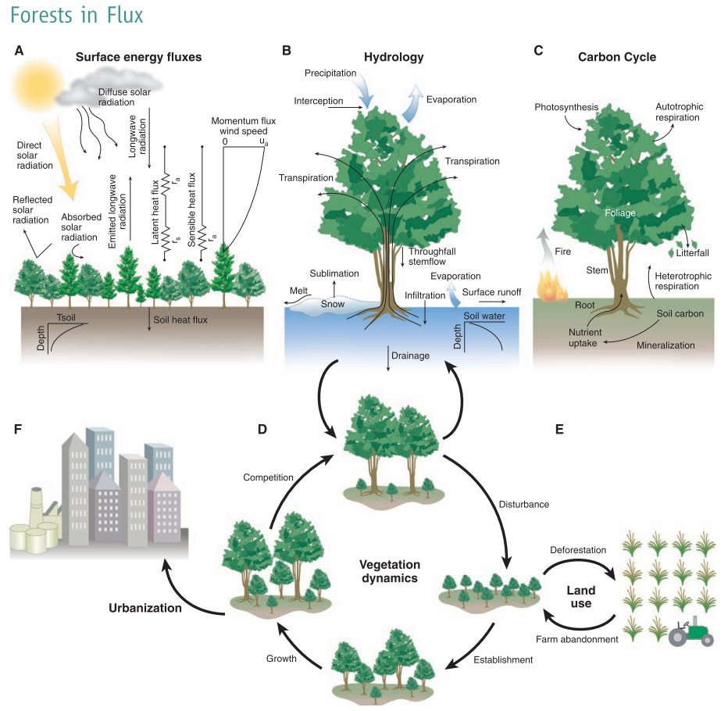
(Bonan, 2008)

